Slide 1
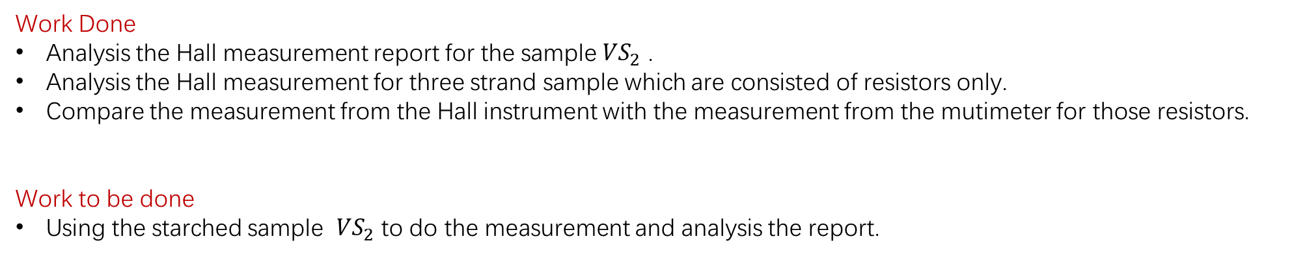
Weekly report 12/2/2019-12/8/2019 Tengteng Tao
Work Done
Analysis the Hall measurement report for the sample ${VS}_{2}$ .
Analysis the Hall measurement for three strand sample which are consisted of resistors only.
Compare the measurement from the Hall instrument with the measurement from the mutimeter for those resistors.
Work to be done
Using the starched sample ${VS}_{2}$ to do the measurement and analysis the report.

Slide 2
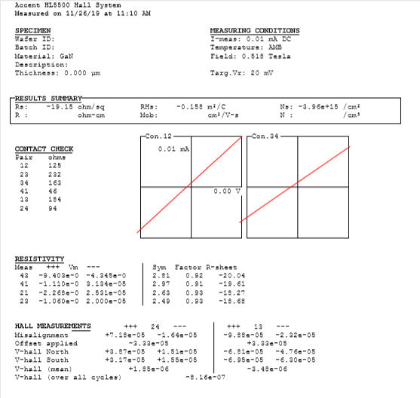
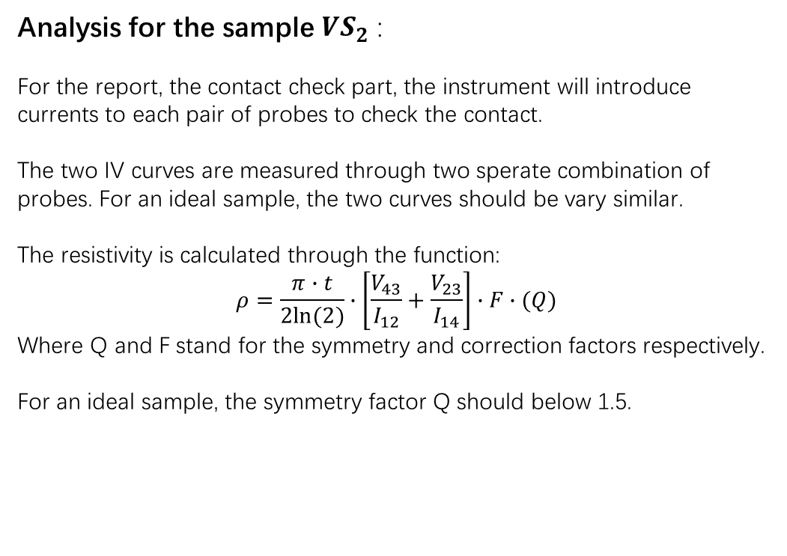
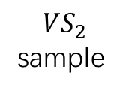
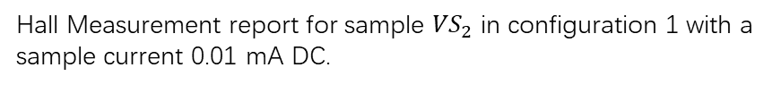
Weekly report 12/2/2019-12/8/2019 Tengteng Tao
Analysis for the sample ${VS}_{2}$ :
For the report, the contact check part, the instrument will introduce currents to each pair of probes to check the contact.
The two IV curves are measured through two sperate combination of probes. For an ideal sample, the two curves should be vary similar.
The resistivity is calculated through the function:
$$ρ=\frac{π∙t}{2ln⁡(2)}∙\left[\frac{V_{43}}{I_{12}}+\frac{V_{23}}{I_{14}}\right]∙F∙(Q)$$
Where Q and F stand for the symmetry and correction factors respectively.
For an ideal sample, the symmetry factor Q should below 1.5.
`
Configuration 1:
Probe 1: Pin4
Probe 2: Pin2
Probe 3: Pin26
Probe 4: Pin22
Pin 4
Pin 22
$${VS}_{2}$$
sample
Configuration 2:
Probe 1: Pin22
Probe 2: Pin4
Probe 3: Pin2 Probe 4: Pin26
Hall Measurement report for sample ${VS}_{2}$ in configuration 1 with a sample current 0.01 mA DC.
Pin 2
Pin 26

Slide 3
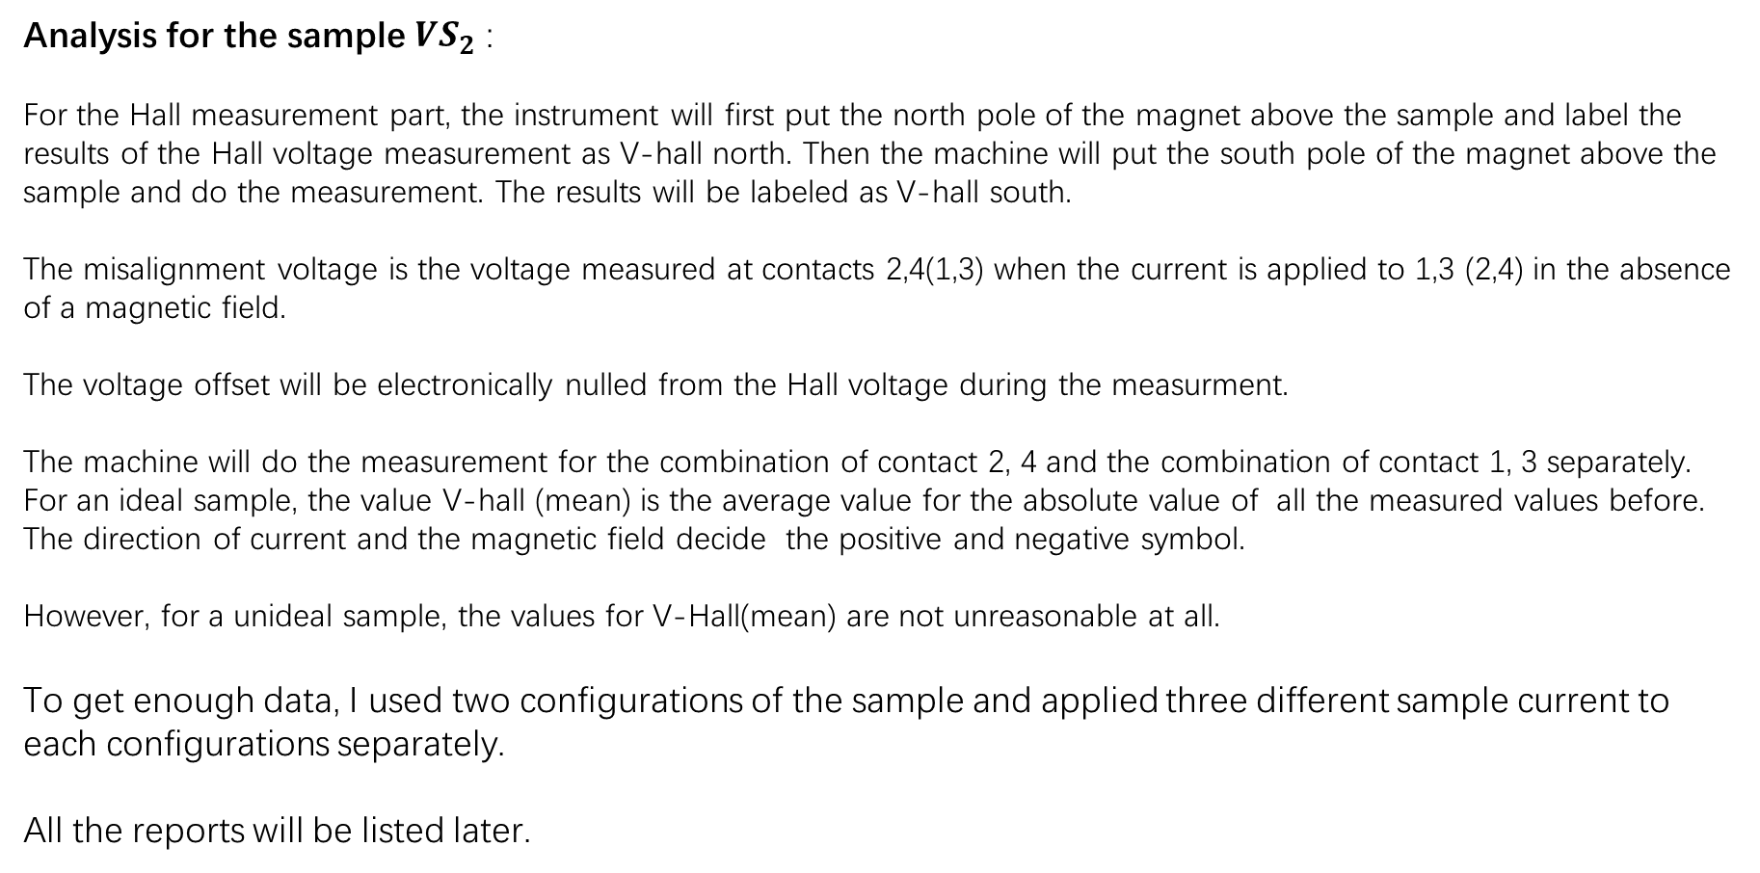
Weekly report 12/2/2019-12/8/2019 Tengteng Tao
Analysis for the sample ${VS}_{2}$ :
For the Hall measurement part, the instrument will first put the north pole of the magnet above the sample and label the results of the Hall voltage measurement as V-hall north. Then the machine will put the south pole of the magnet above the sample and do the measurement. The results will be labeled as V-hall south.
The misalignment voltage is the voltage measured at contacts 2,4(1,3) when the current is applied to 1,3 (2,4) in the absence of a magnetic field.
The voltage offset will be electronically nulled from the Hall voltage during the measurment.
The machine will do the measurement for the combination of contact 2, 4 and the combination of contact 1, 3 separately. For an ideal sample, the value V-hall (mean) is the average value for the absolute value of all the measured values before. The direction of current and the magnetic field decide the positive and negative symbol.
However, for a unideal sample, the values for V-Hall(mean) are not unreasonable at all.
To get enough data, I used two configurations of the sample and applied three different sample current to each configurations separately.
All the reports will be listed later.

Slide 4
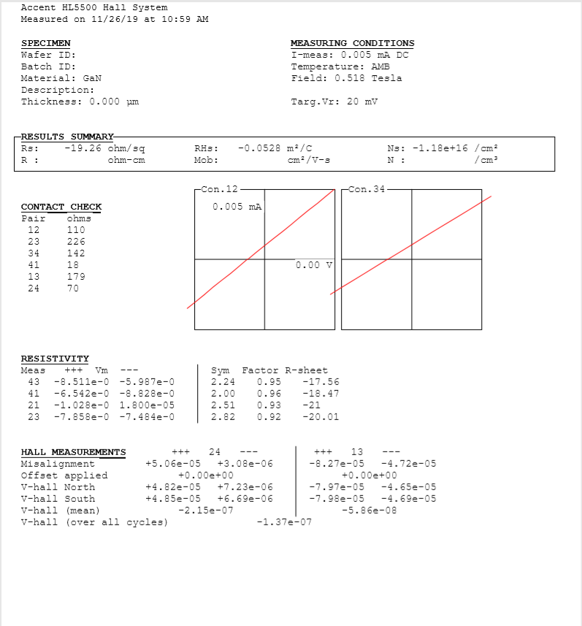
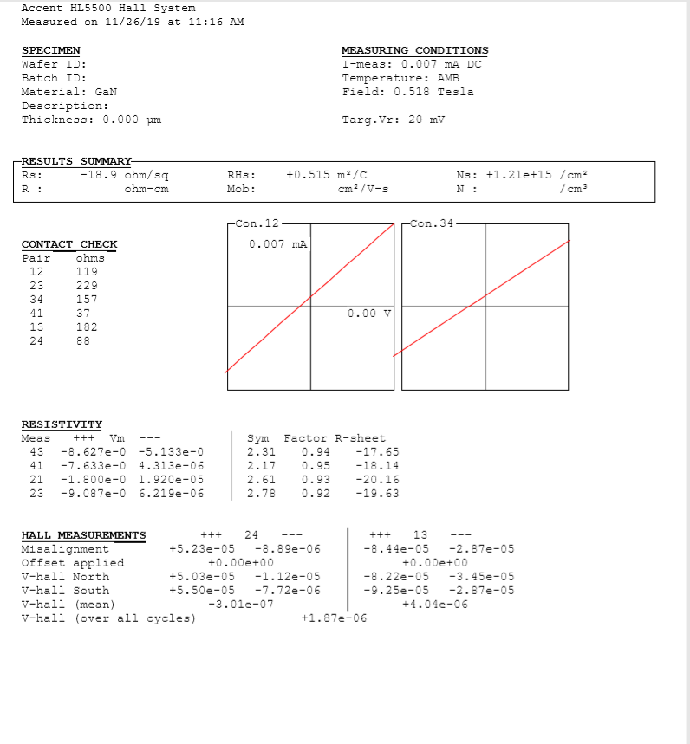
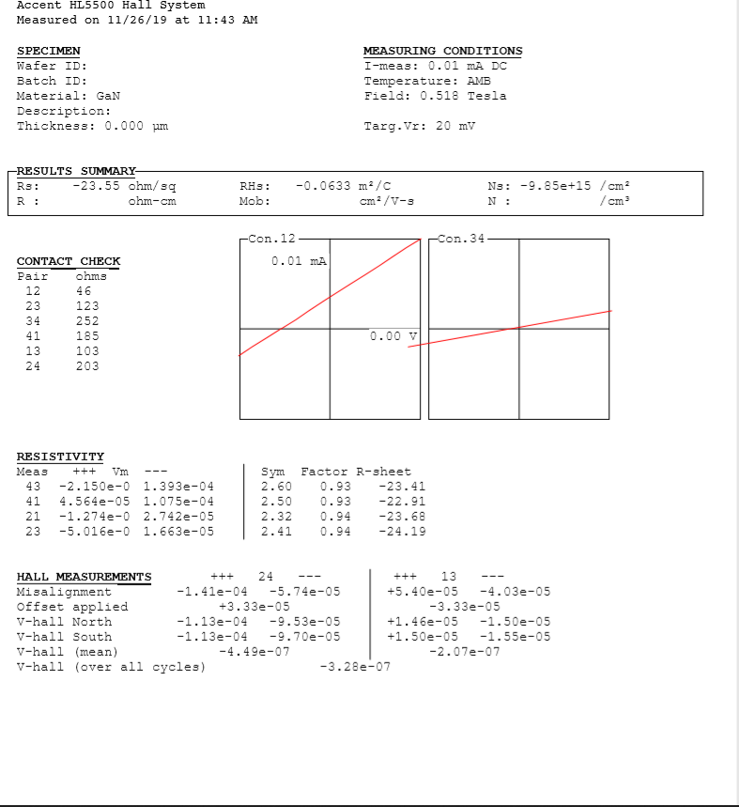
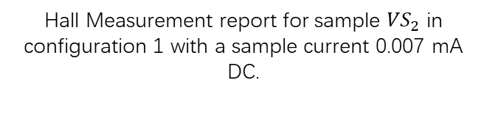
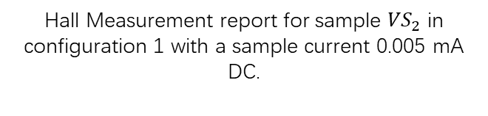
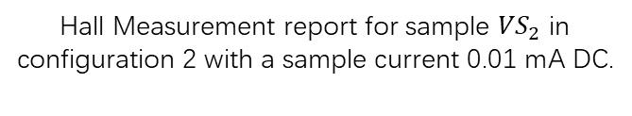
Weekly report 12/2/2019-12/8/2019 Tengteng Tao
Reports for the sample ${VS}_{2}$ :
`
Hall Measurement report for sample ${VS}_{2}$ in configuration 1 with a sample current 0.005 mA DC.
Hall Measurement report for sample ${VS}_{2}$ in configuration 1 with a sample current 0.007 mA DC.
Hall Measurement report for sample ${VS}_{2}$ in configuration 2 with a sample current 0.01 mA DC.

Slide 5
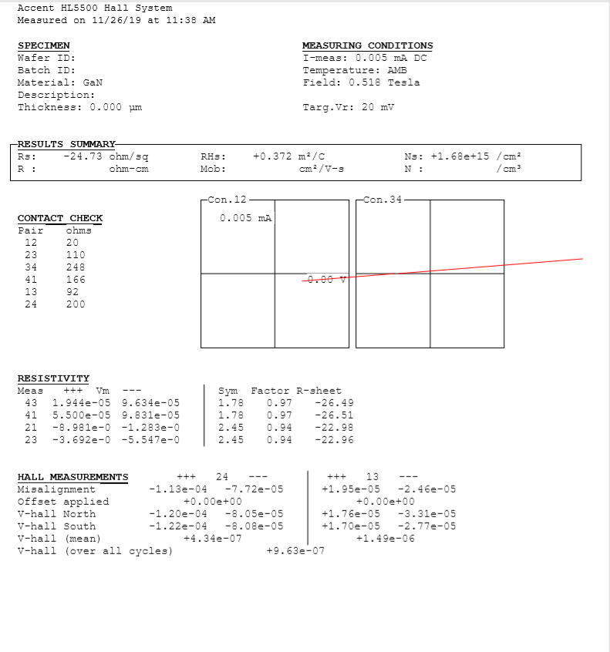
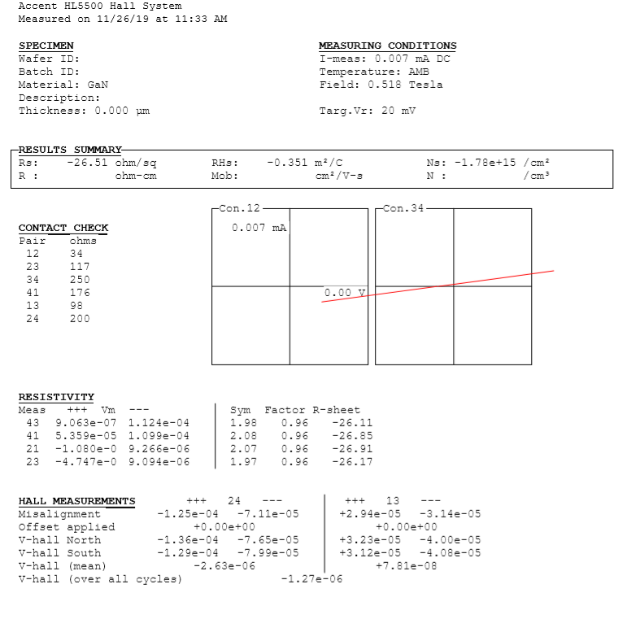
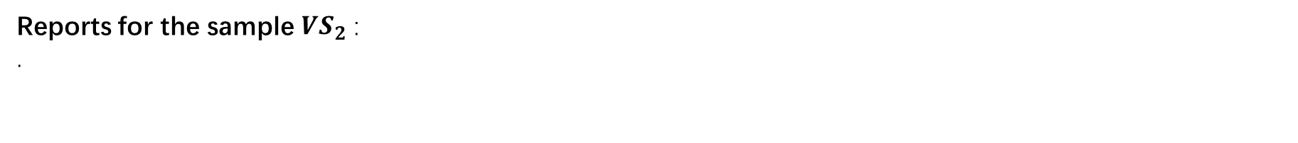
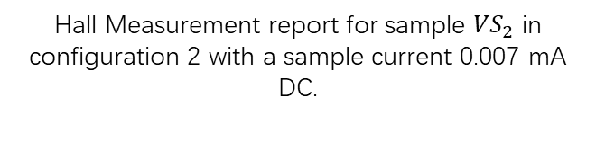
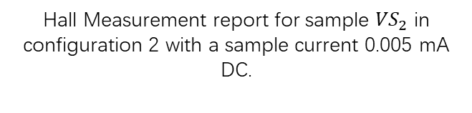
Weekly report 12/2/2019-12/8/2019 Tengteng Tao
Reports for the sample ${VS}_{2}$ :
.
`
Hall Measurement report for sample ${VS}_{2}$ in configuration 2 with a sample current 0.005 mA DC.
Hall Measurement report for sample ${VS}_{2}$ in configuration 2 with a sample current 0.007 mA DC.

Slide 6
Weekly report 12/2/2019-12/8/2019 Tengteng Tao
Conclusion for those measurements:
According to reports, we can see that the symmetry factors in all six reports are larger than 1.5, which means our sample is nor ready for a Hall measurement. Accordingly, the results from the part Hall Measurement are not reliable at all.
In addition, the IV curve part, the machine will apply the current to the sample up to the limit we set, but in our sample, the values of the voltage are always zero, which means our sample are too conductive to be measured properly.
In order to check the reliability of the machine, I used three standard samples which are consisted of resistors to do the measurements. The currents I applied on the samples all are recommended current listed on the manual.

Slide 7
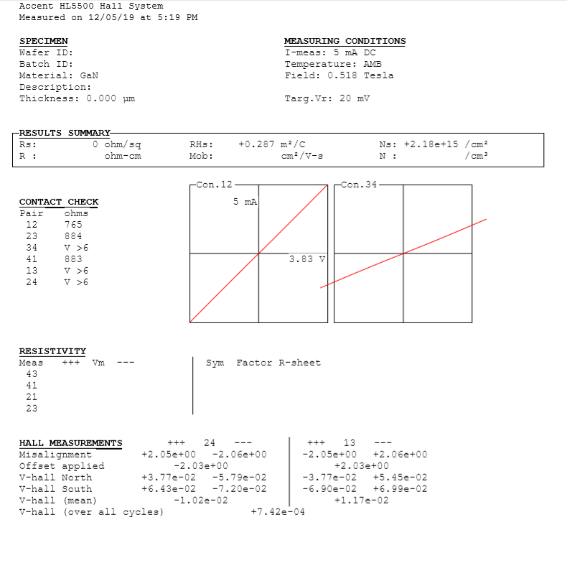
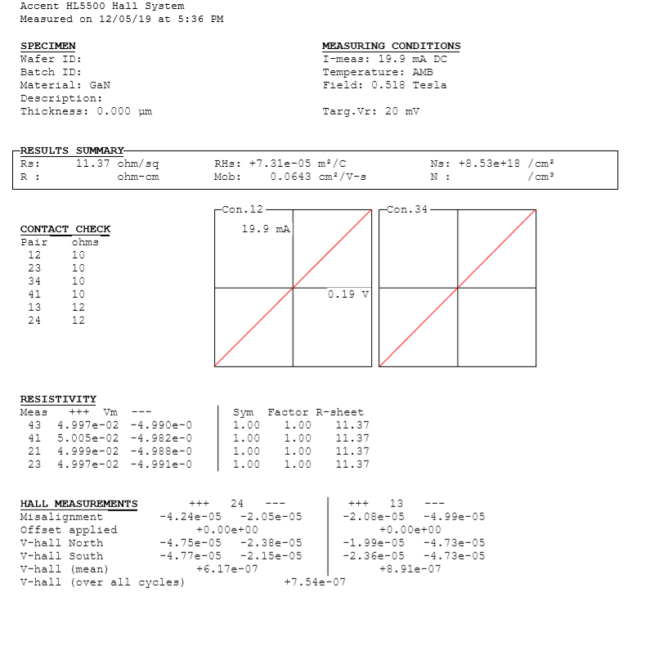
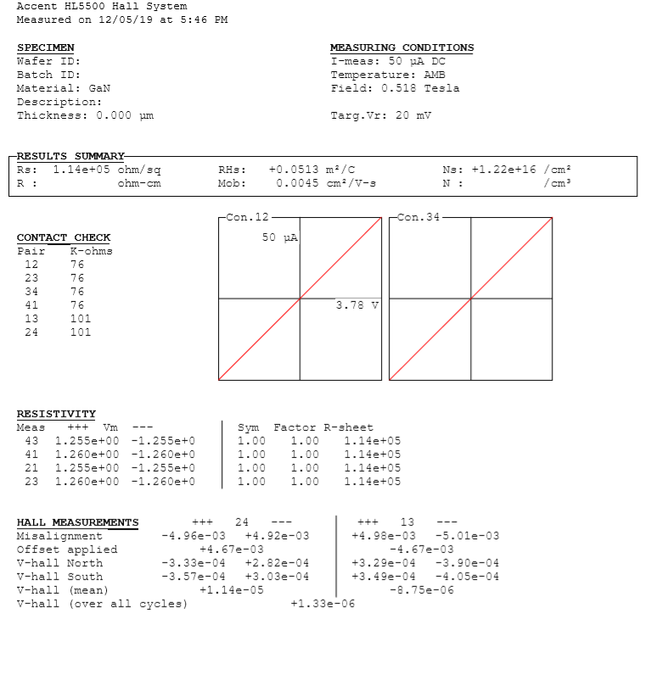
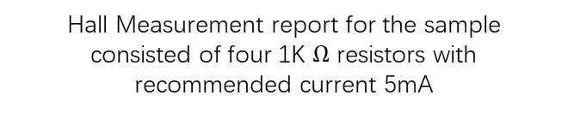
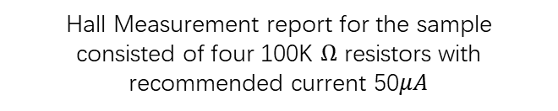
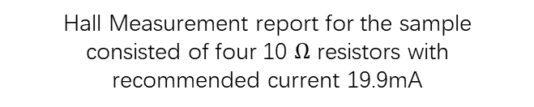
Weekly report 12/2/2019-12/8/2019 Tengteng Tao
Reports for those standard samples:
Hall Measurement report for the sample consisted of four 1K $Ω$ resistors with recommended current 5mA
Hall Measurement report for the sample consisted of four 10 $Ω$ resistors with recommended current 19.9mA
Hall Measurement report for the sample consisted of four 100K $Ω$ resistors with recommended current 50$μA$

Slide 8
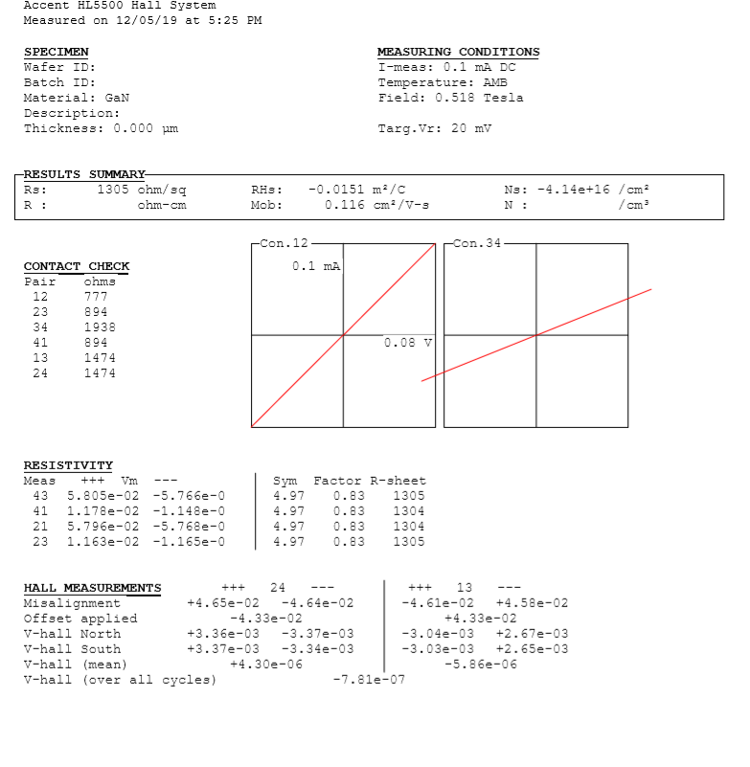
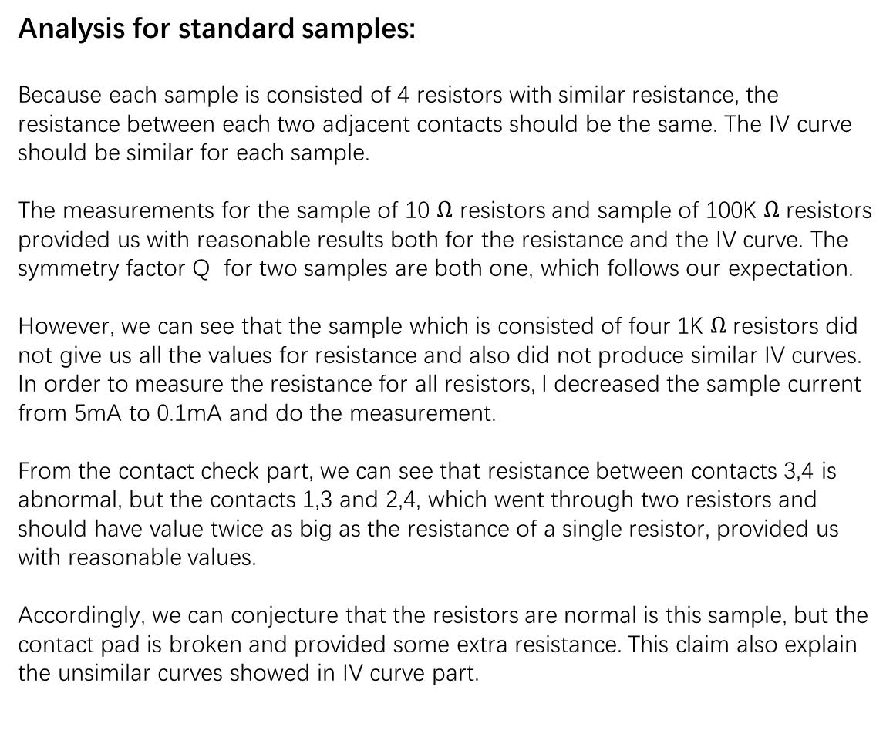
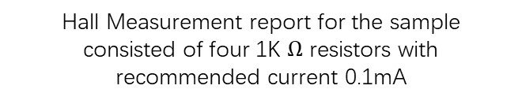
Weekly report 12/2/2019-12/8/2019 Tengteng Tao
Analysis for standard samples:
Because each sample is consisted of 4 resistors with similar resistance, the resistance between each two adjacent contacts should be the same. The IV curve should be similar for each sample.
The measurements for the sample of 10 $Ω$ resistors and sample of 100K $Ω$ resistors provided us with reasonable results both for the resistance and the IV curve. The symmetry factor Q for two samples are both one, which follows our expectation.
However, we can see that the sample which is consisted of four 1K $Ω$ resistors did not give us all the values for resistance and also did not produce similar IV curves. In order to measure the resistance for all resistors, I decreased the sample current from 5mA to 0.1mA and do the measurement.
From the contact check part, we can see that resistance between contacts 3,4 is abnormal, but the contacts 1,3 and 2,4, which went through two resistors and should have value twice as big as the resistance of a single resistor, provided us with reasonable values.
Accordingly, we can conjecture that the resistors are normal is this sample, but the contact pad is broken and provided some extra resistance. This claim also explain the unsimilar curves showed in IV curve part.
Hall Measurement report for the sample consisted of four 1K $Ω$ resistors with recommended current 0.1mA

